Slide 1


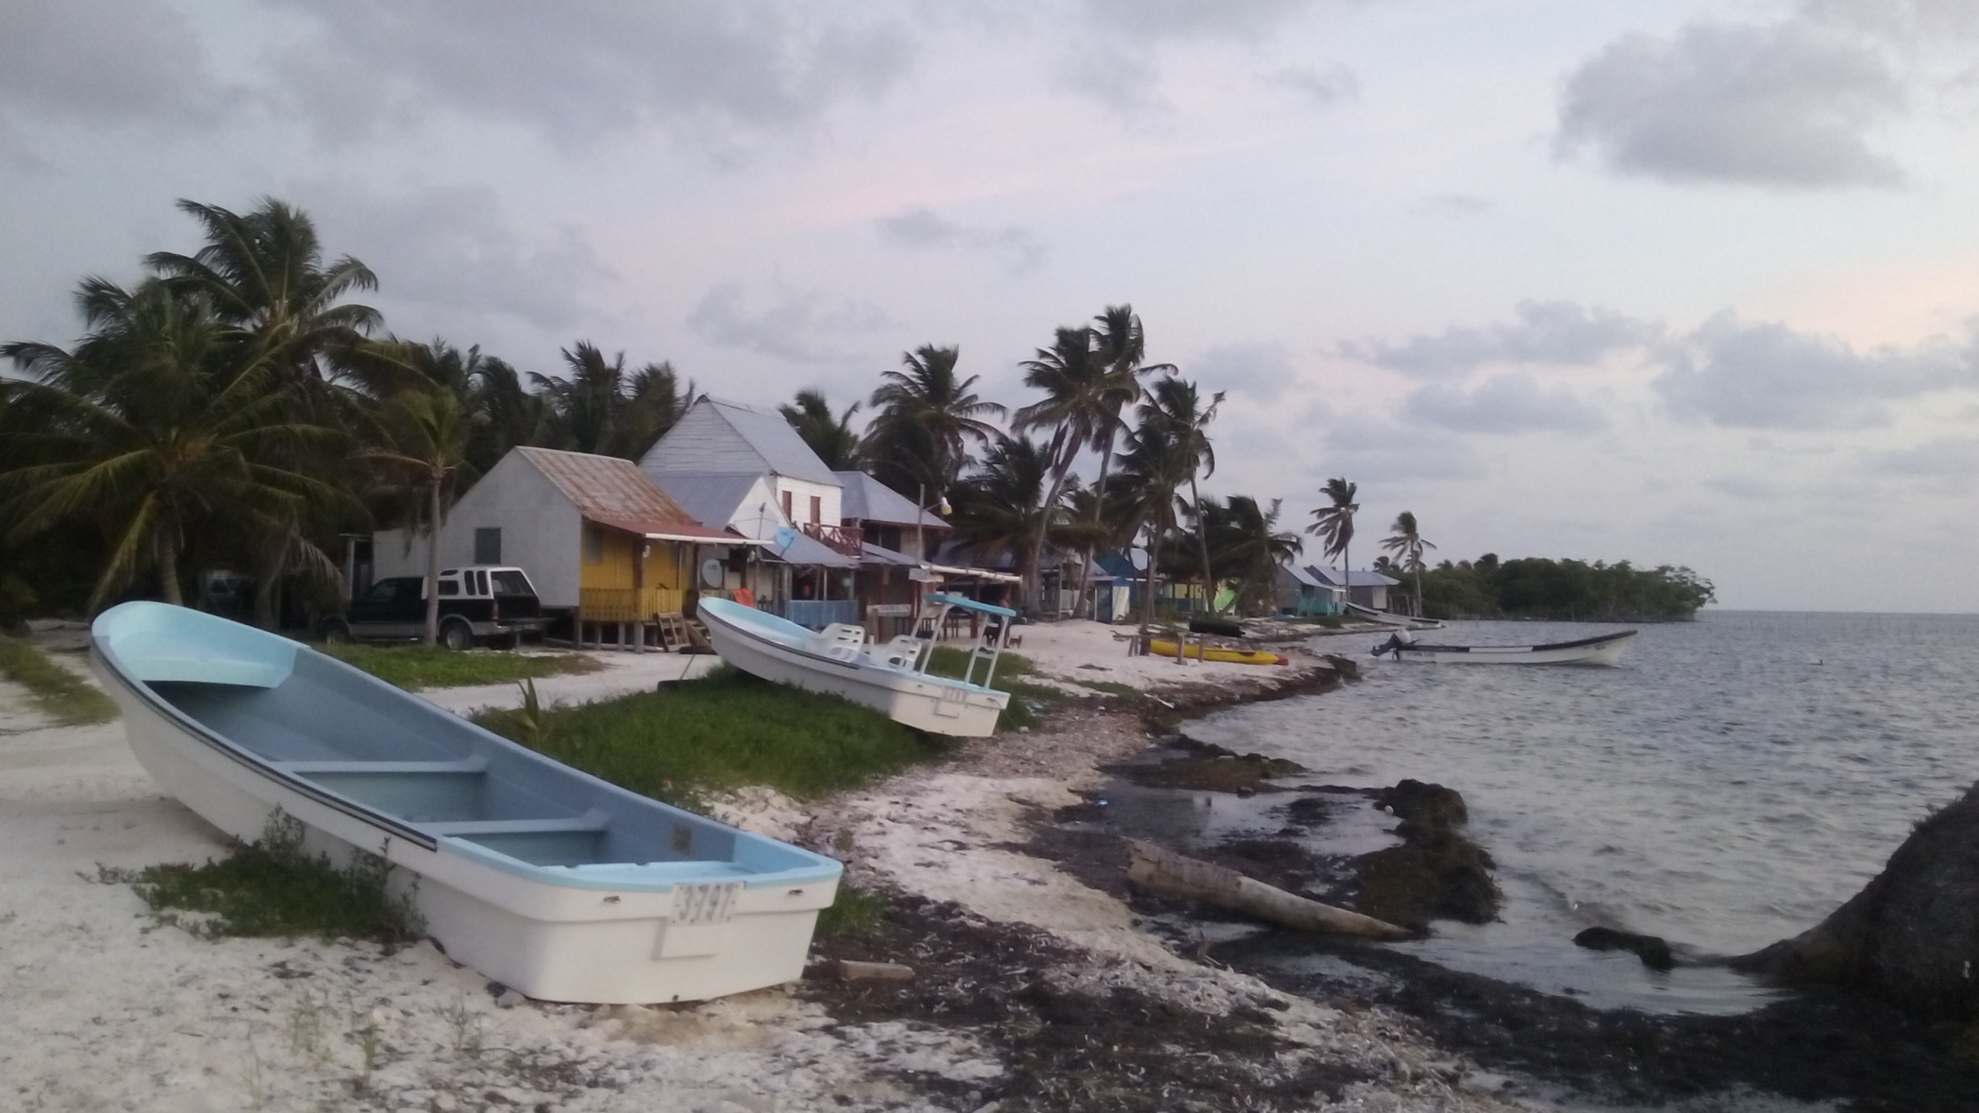
Indicadores para la evaluación de zonas de refugio pesquero
Juan Carlos Villaseñor-Derbez, La Paz, 10 Octubre, 2016
jvillasenor@bren.ucsb.edu

Slide 2

Estructura
Proyecto TURFeffect
Indicadores
Tipos y categorías
Casos de estudio: ZRP Sian Ka’an (Maria Elena, Quintana Roo)

Slide 3
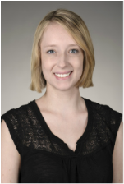
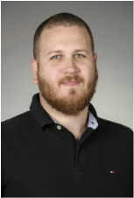
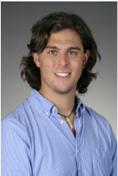
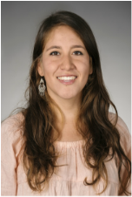
TURFeffect
turfeffect.org
Notes:
Colocar fotos maiores

Slide 4
TURFeffect
Necesidad de lineamientos y métodos estandarizados para la evaluación de zonas de no pesca en México.
Objectives

Slide 5
Pasos
Replicar
Reportar
Análisis
Indicadores
Objetivos

Slide 6
Escalas
Poner que los análisis e indicadores tienen diferentes escalas (comunidad humana, reserva, comunidad ecológica, población, especie)

Slide 7
Indicadores
Tres categorías:
Biofísicos
Socioeconómicos
Gobernanza
Tres tipos:
Dependientes
Independientes
Covariables

Slide 8
Indicadores Biofísicos
Indicador | Descripción | Escala | Tipo
Riqueza de especies | Promedio de riqueza de especies por unidad de área | Con | Dep
Densidad * | Promedio de número de organismos por unidad de área | Cont | Dep
Densidad de organismos potencialmente maduros * | Promedio de número de organismos mayores que LT₅₀ por unidad de área | Cont | Dep
Biomasa * | Promedio de biomasa por unidad de área | Cont | Dep
Nivel trófico | Media ponderada del nivel trófico: | Cont | Dep
Diversidad de Shannon | Promedio del índice de diversidad de Shannon | Con | Dep
Fenómenos naturales | Descripción de fenómenos naturales que pudieran dar una explicación del comportamiento de los indicadores anteriores. | Desc | Ind
Notes:
Tabela

Slide 9
Indicadores Socioeconómicos
Indicator | Description | Scale
Total landings | Annual landings of all fished species (mt/year). | Continuous
Objective species landings | Annual landings of each objective species (mt/year). Objective species are species intended to be protected by the reserve. | Continuous
Alternative economic opportunities | Has the availability of alternative economic opportunities increased, decreased, or stayed the same after implementation of the reserve? | Ordinal
Community knowledge of the reserves | Degree of knowledge the fishers have about the reserve type and reserve objectives. Creation of a Knowledge index with 5 indicators (Type of reserve, Year of implementation, Density, Species richness, Predators abundance) where less than 3 right answers is a low knowledge of the reality, from 3 and 4 is intermediate knowledge and 5 is high. | Ordinal

Slide 10
Indicadores Gobernanza
Indicador | Descripción | Escala
Access to the fishery | Type of policy to control access to the fishery (TURF, Permits, Open access, etc.). | Categorical
Number of fishers | Number of fishers who fish in the area. | Discrete
Legal recognition of reserve | Does the reserve have a legal recognition? | Binary
Reserve type | Type of reserve (core zone, refugio pesquero, voluntarily owned), duration of reserve (temporary or permanent), and level of protection (partial, total). | Descriptive
Illegal harvesting | Level of illegal harvesting as perceived by fishers. | Ordinal
Management plan | Does the reserve have a management plan that guides current and future activities, identifies priority management issues, and proposes actions to address these issues? | Ordinal
Reserve enforcement | Is there enforcement? If yes, how is the reserve enforced? | Descriptive
Size of reserve | Is size of the reserve large enough to cover the home range of the objective species? | Discrete
Reasoning for reserve location | Short description of why the reserve location was chosen. | Descriptive
Membership to fisher organizations | Are fishers organized (members of a group where they have voluntarily agreed to work together toward a common objective)? Yes or no? | Binary
Type of fisher organizations | How fishers are organized (cooperative, association, committee, union or other type of fisher organization)? There may be multiple organizations of fishers for one reserve. | Categorical
Representation | Diverse and inclusive representation of participants in management (implementation, monitoring, adaptation). | Ordinal

Slide 11
ZRP Quintana Roo
3 Comunidades
Maria Elena
4 ZRP analizadas
Monitoreos anuales
Pesca – No Pesca
Primera prueba de evaluación

Slide 12
Objetivos
1. Contribuir a recuperar las poblaciones de especies objetivo de las pesquerías, como langosta, caracol rosado y varias especies de peces, ayudando al reclutamiento, el crecimiento y la densidad para mejorar el éxito reproductivo.
2. Contribuir a mejorar la productividad pesquera a mediano plazo recuperando la biomasa.
3. Ayudar a aumentar la resiliencia de los ecosistemas y de la pesca ante perturbaciones climáticas o presiones antropogénicas.
4. Proteger una porción del hábitat, la biodiversidad y los procesos ecológicos de los ecosistemas coralinos, de la laguna arrecifal y de los humedales, con la restauración de sus funciones tróficas de importancia para las especies comerciales pesqueras.

Slide 13
Indicadores seleccionados
Biofísicos:
Densidad (p, i, o)
Riqueza (p)
Biomasa (p, o)
Estructura trófica (p)
Notes:
Incluir los indicadores que faltan

Slide 14
Resultados disponibles
www.jcvdav.github.io/QRoo

Slide 15
Resumen de resultados
Mayoría de sitios e indicadores en incremento significativo
Riqueza (-)
Densidad (+)
Biomasa (+)
Tiempo de recuperación aproximado de langosta = 12 años (MSY)

Slide 16
BIOFÍSICOS SOCIOECONÓMICOS GOBERNANZA
Indicador 1
Indicador 2
Indicador 3…
.
.
.
.
.
Indicador n
Indicador 1
Indicador 2
Indicador 3…
.
.
.
.
.
Indicador n
Indicador 1
Indicador 2
Indicador 3…
.
.
.
.
.
Indicador n
LEYENDA GENERAL DESCARGAR REPORTE
Incremento significativo
Incremento
Sin cambio
Decremento
Decremento significativo
B
SE
G
Notes:
Fore each Indicador:
Colors are given based on the DID value and itr significance value. A positive and significant value would be green, a positive but not significant light green… and so on. On the back of the APP, these colors would be 1 for red and 5 for dark green, which will enable us to do some nice things for the next step:
For the “category-wise” Indicador (the outer part of the circle):
Color of each third (yes, they are supposed to be thirds of a circle hehe) is given by a simple calculation where dark green would be that all Indicadors are green. Since we have numbers matching each color (red = 1, dark green =5), and we know that we used, say, 6 biophysical Indicadors, the maximum sum shoud be 30 (that’s 6 X 5). Therefore, if the scores for our 6 Indicador swere {1,3,4,4,5,4}, that adds up to 21, from a maximum possible of 30. That maximum of 30 can be split into 5 ranges 1-6, 7-12, 13-18, 19-24, and 25-30, where they would be red, orange, yellow, light green and dark green, respectively. The good thing about this is that it could work for any number of Indicadors. If we had 20 Indicadors, maximum would be 100, and ranges would just be different (think of them as quantiles).
For the entire thing (thats the center of the circle):
Something similar happens either taking into account ALL the Indicadors of each category… Or perhaps a weighted average of the three category-wise Indicadors. The weight will be based on how much they value each of the categories (i.e. I like more fish than people, so I will weight biophysical higher than socio-economic)…

Slide 17
